Slide 1
Thresholds and Payoffs

Slide 2
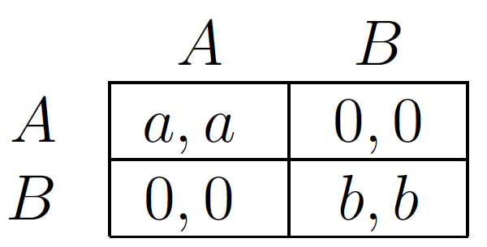
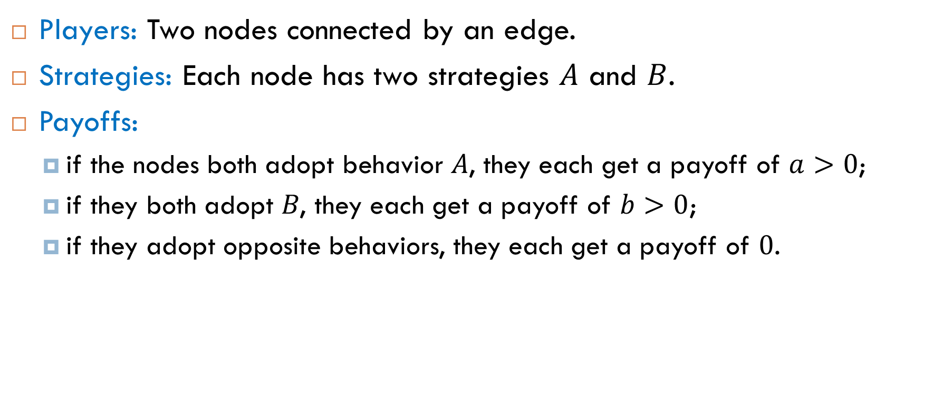
Game for a Single Edge
Players: Two nodes connected by an edge.
Strategies: Each node has two strategies $A$ and $B$.
Payoffs:
if the nodes both adopt behavior 𝐴, they each get a payoff of $a>0$;
if they both adopt 𝐵, they each get a payoff of $b>0$;
if they adopt opposite behaviors, they each get a payoff of $0$.

Slide 3
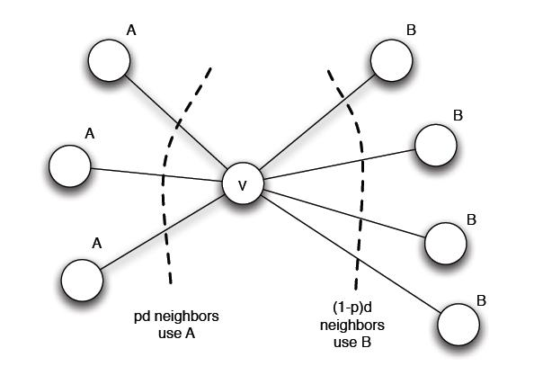
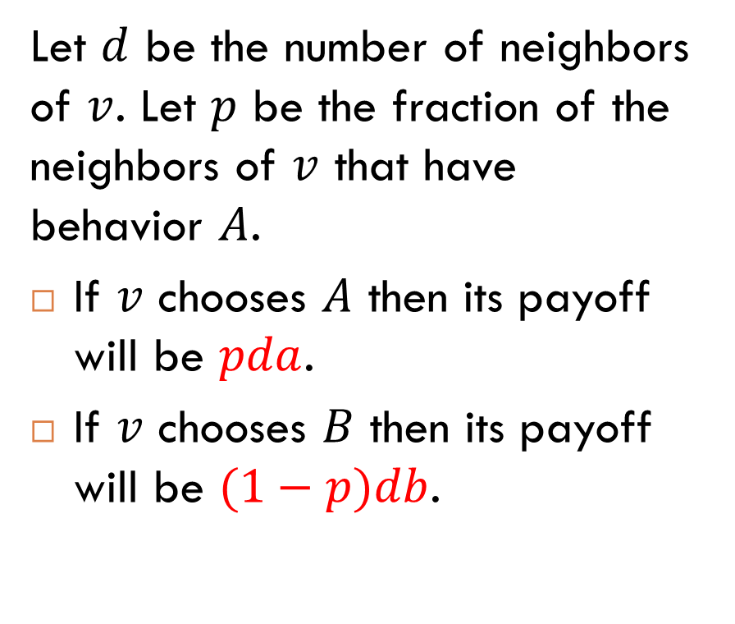
More Than One Neighbor
Let $d$ be the number of neighbors of $v$. Let $p$ be the fraction of the neighbors of $v$ that have behavior $A$.
If $v$ chooses $A$ then its payoff will be $pda$.
If $v$ chooses $B$ then its payoff will be $(1−p)db$.

Slide 4

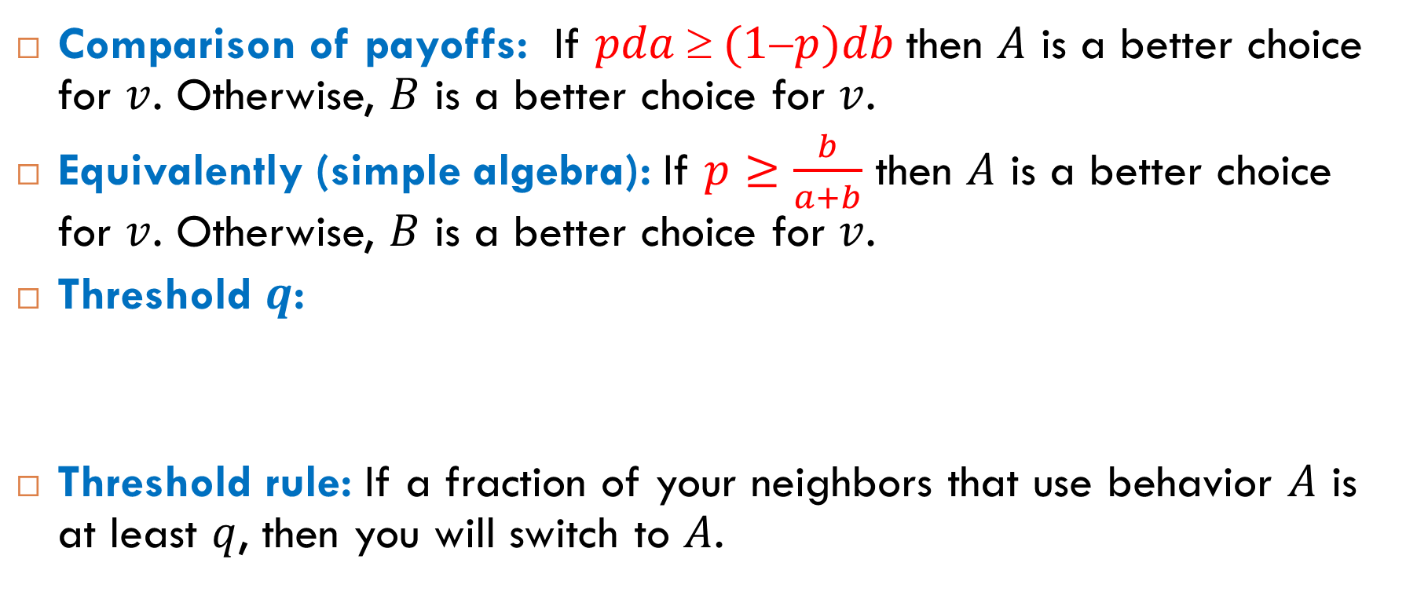
Threshold Rule
Comparison of payoffs: If $pda  (1p)db$then $A$ is a better choice for $v$. Otherwise, $B$ is a better choice for $v$.
Equivalently (simple algebra): If $p≥\frac{b}{a+b}$ then $A$ is a better choice for $v$. Otherwise, $B$ is a better choice for $v$.
Threshold $q$:
Threshold rule: If a fraction of your neighbors that use behavior $A$ is at least $q$, then you will switch to $A$.
$$q=\frac{b}{a+b}$$

Slide 5
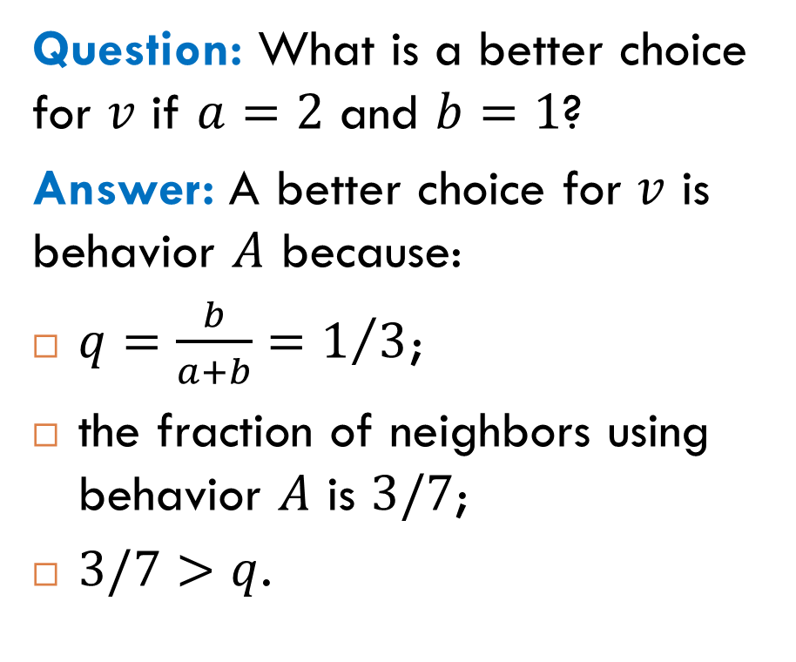
Example
Question: What is a better choice for $v$ if $a=2$ and $b=1$?
Answer: A better choice for $v$ is behavior $A$ because:
$q=\frac{b}{a+b}=1/3$;
the fraction of neighbors using behavior $A$ is $3/7$;
$3/7>q$.

Slide 6

Exercise
Question: What is a better choice for $v$ if $a=3$ and $b=2$?
Answer: A better choice for $v$ is behavior $A$ because:
$q=\frac{b}{a+b}=2/5$;
the fraction of neighbors using behavior $A$ is $3/7$;
$3/7>q$.

Slide 7
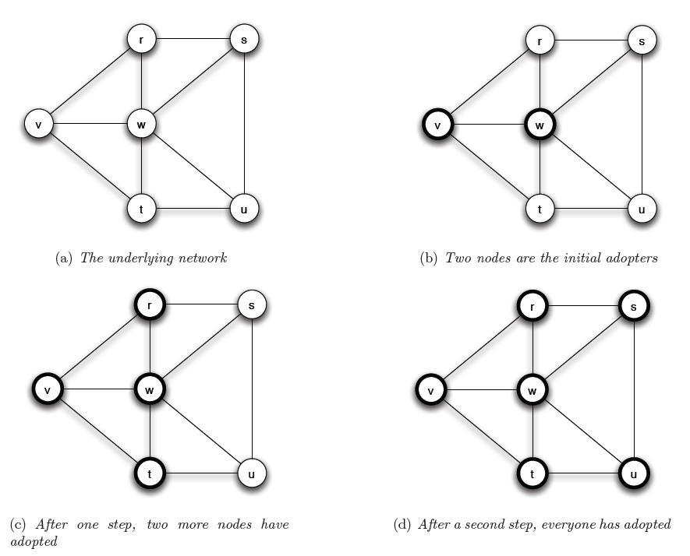

Example: Complete Cascade
$$a=3$$
$$b=2$$

Slide 8
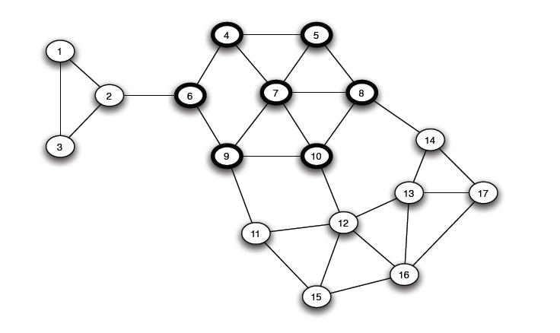
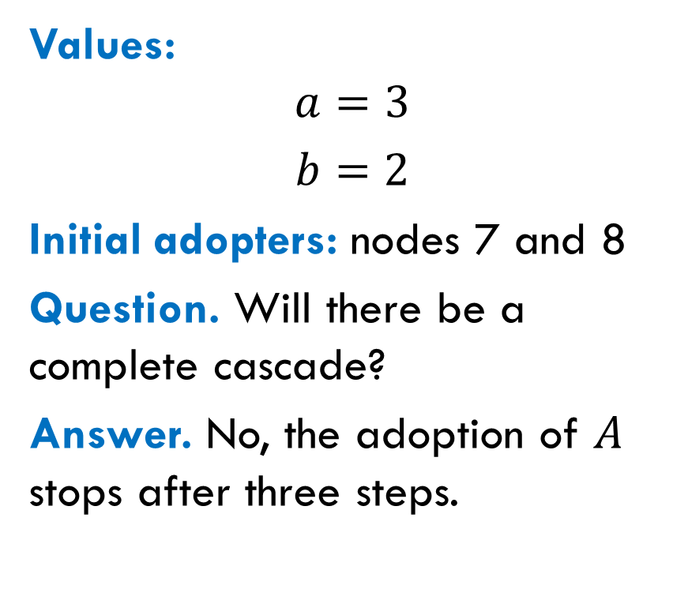
Another Example: Cascade Stops
Values:
$$a=3$$
$b=2$
Initial adopters: nodes 7 and 8
Question. Will there be a complete cascade?
Answer. No, the adoption of $A$ stops after three steps.

Slide 9
Cascades and Clusters
Densely Connected Groups

Slide 10
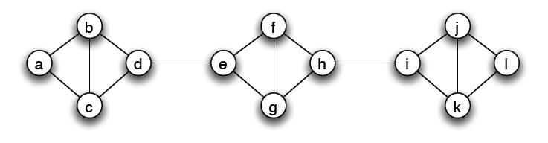
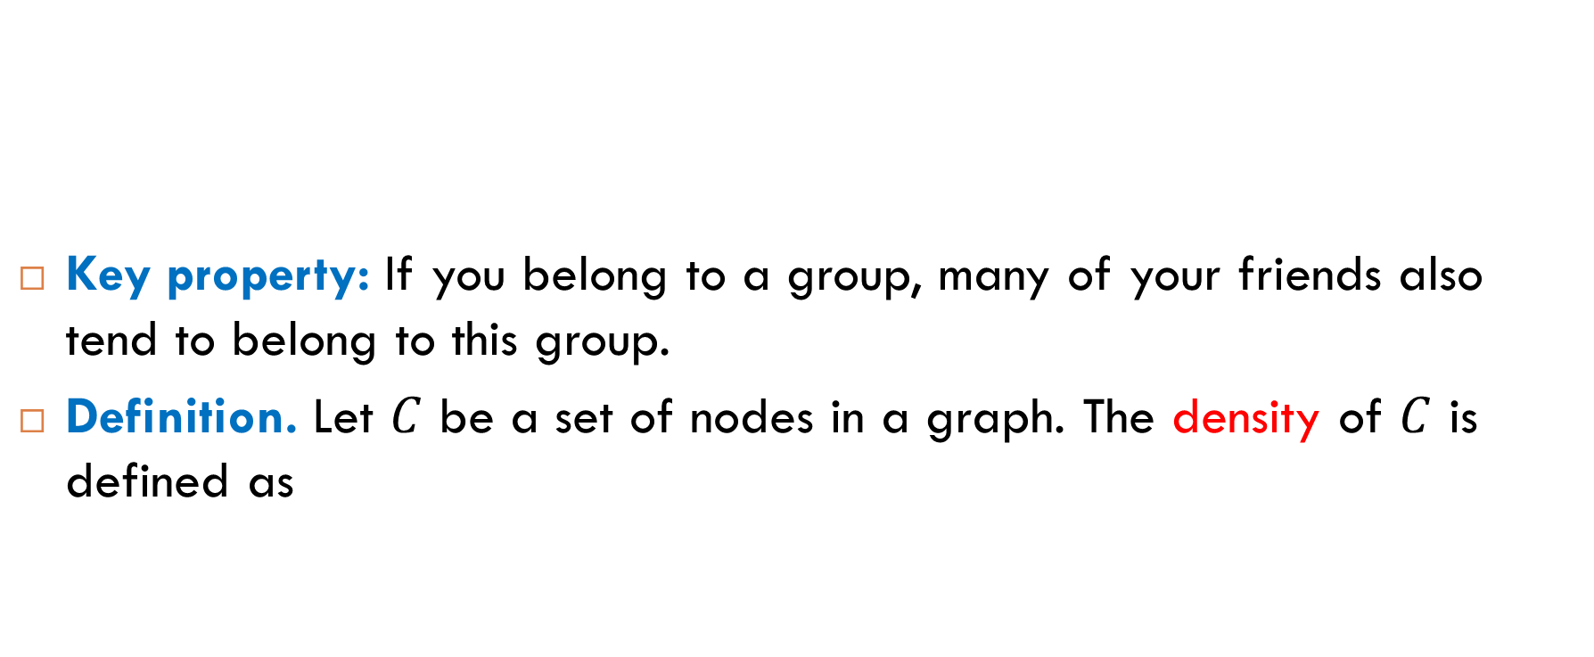
Density
Key property: If you belong to a group, many of your friends also tend to belong to this group.
Definition. Let $C$ be a set of nodes in a graph. The density of $C$ is defined as
$$\min_{v∈C}{\{\text{the} \text{fraction} \text{of} v^{′}\text{s} \text{neighbors} \text{belonging} \text{to} C\}}$$

Slide 11
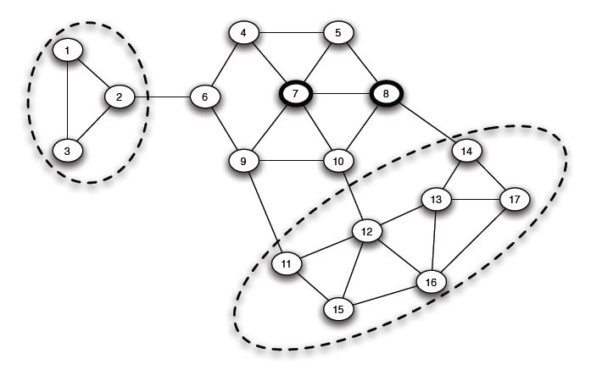

Example
Two groups of density $2/3$:

Slide 12

Another Example
The group $C=\{a, b, c, d\}$ also has density $2/3$.

Slide 13
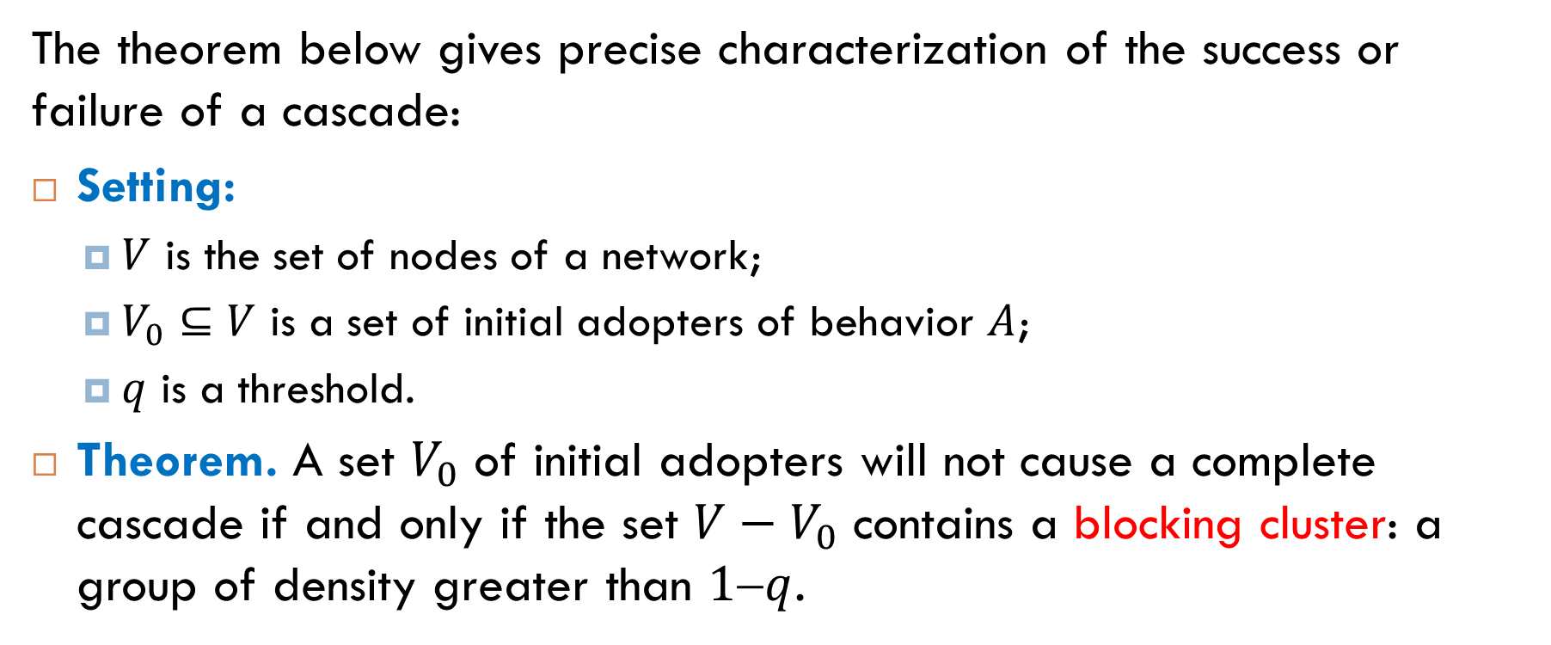
Cascades and Density of Groups
The theorem below gives precise characterization of the success or failure of a cascade:
Setting:
$V$ is the set of nodes of a network;
$V_{0}⊆V$ is a set of initial adopters of behavior $A$;
$q$ is a threshold.
Theorem. A set $V_{0}$ of initial adopters will not cause a complete cascade if and only if the set $V−V_{0}$ contains a blocking cluster: a group of density greater than $1q$.

Slide 14
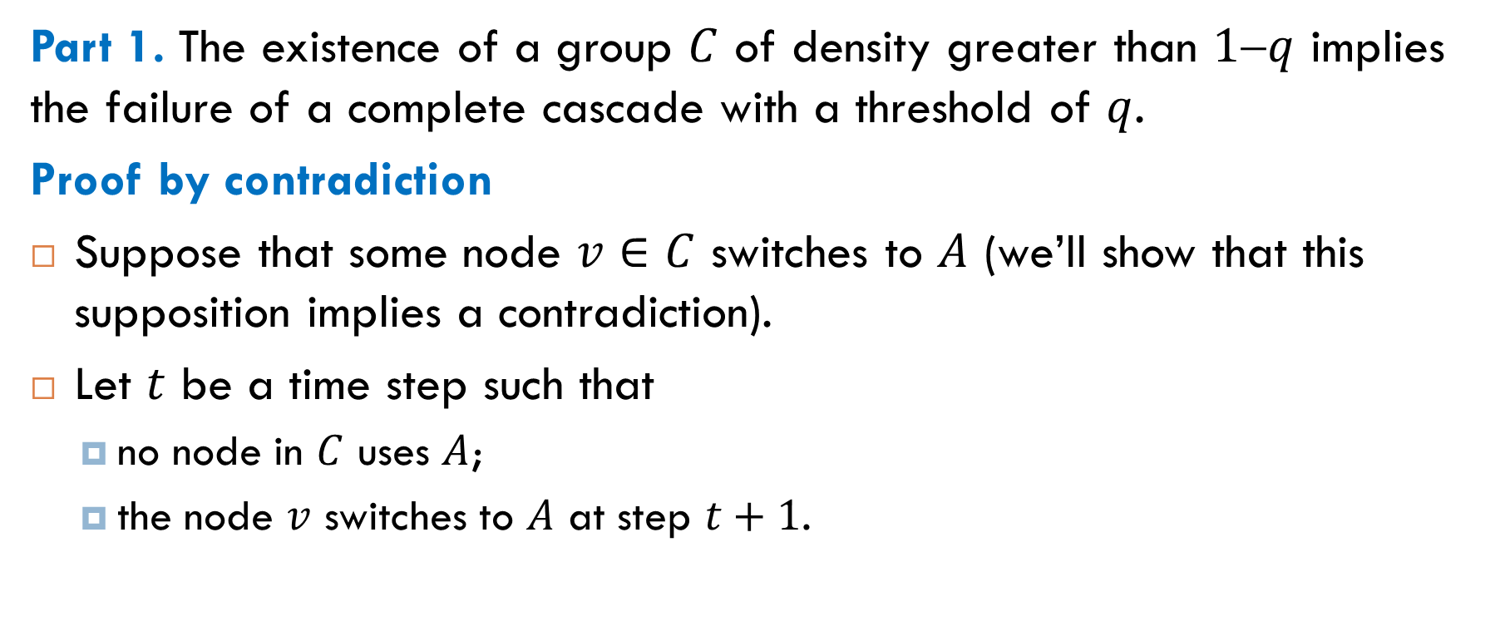
Proof of Part 1
Part 1. The existence of a group $C$ of density greater than $1q$ implies the failure of a complete cascade with a threshold of $q$.
Proof by contradiction
Suppose that some node $v∈C$ switches to $A$ (we’ll show that this supposition implies a contradiction).
Let $t$ be a time step such that
no node in $C$ uses $A$;
the node $v$ switches to $A$ at step $t+1$.

Slide 15
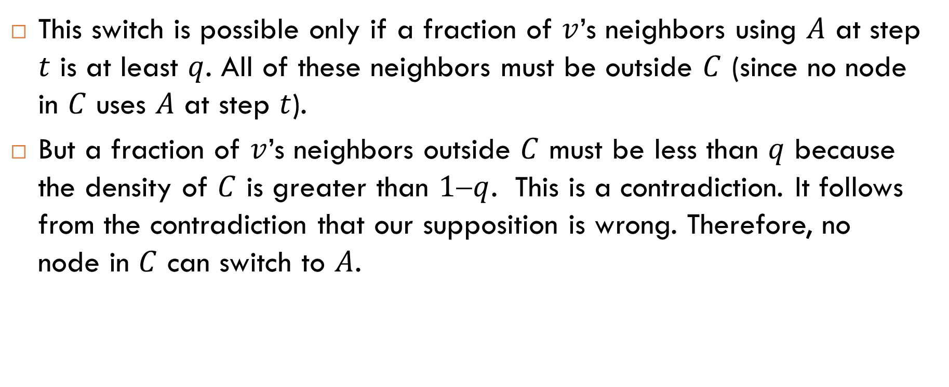
Proof of Part 1 (contd.)
This switch is possible only if a fraction of $v$’s neighbors using $A$ at step $t$ is at least $q$. All of these neighbors must be outside $C$ (since no node in $C$ uses $A$ at step $t$).
But a fraction of $v$’s neighbors outside $C$ must be less than $q$ because the density of $C$ is greater than $1q$. This is a contradiction. It follows from the contradiction that our supposition is wrong. Therefore, no node in $C$ can switch to $A$.

Slide 16
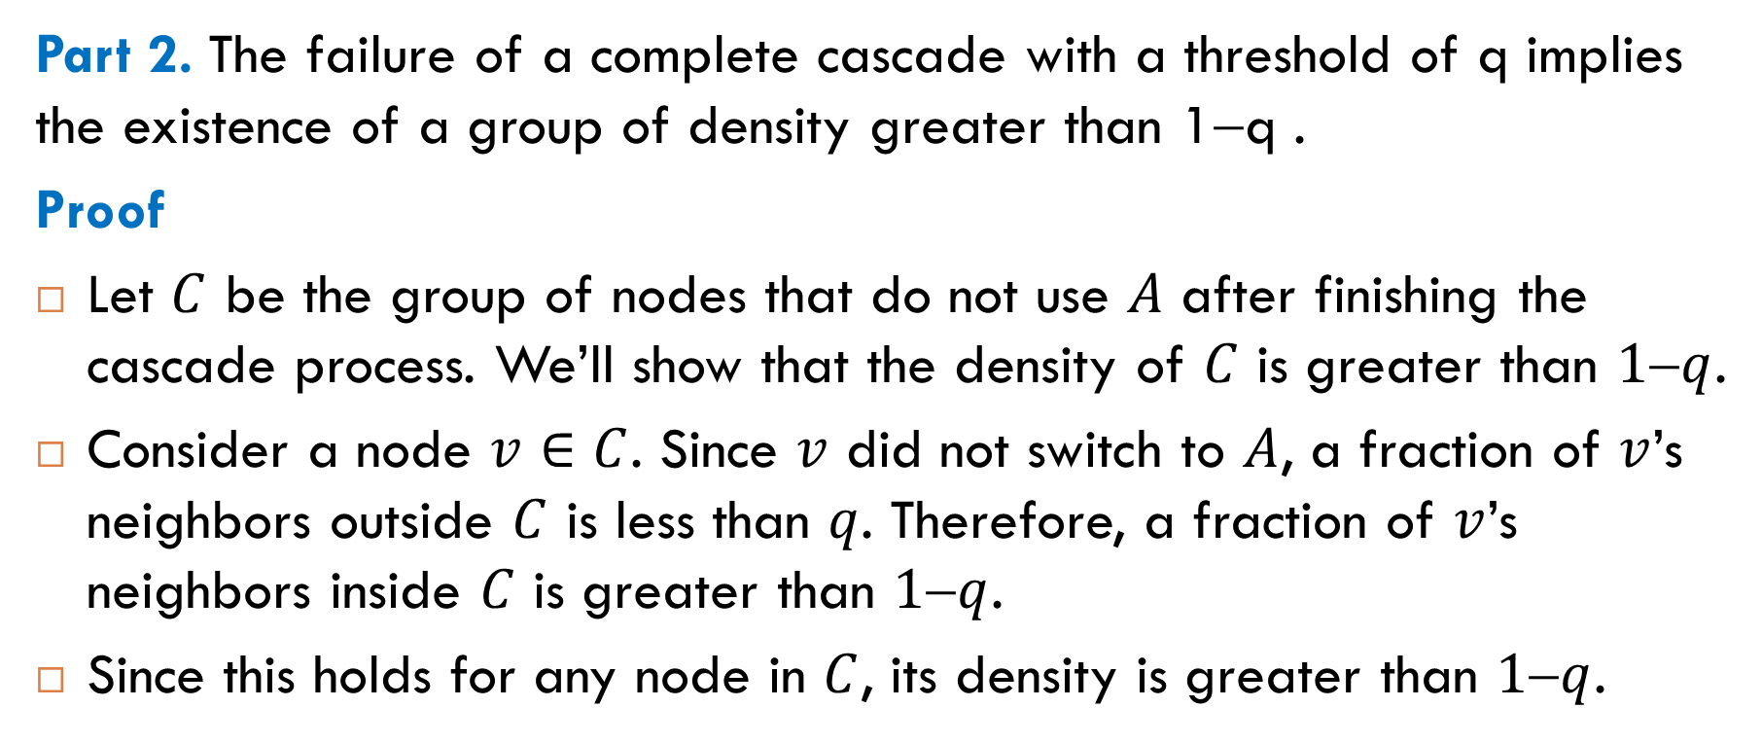
Proof of Part 2
Part 2. The failure of a complete cascade with a threshold of q implies the existence of a group of density greater than 1−q .
Proof
Let $C$ be the group of nodes that do not use $A$ after finishing the cascade process. We’ll show that the density of $C$ is greater than $1q$.
Consider a node $v∈C$. Since $v$ did not switch to $A$, a fraction of $v$’s neighbors outside $C$ is less than $q$. Therefore, a fraction of $v$’s neighbors inside $C$ is greater than $1q$.
Since this holds for any node in $C$, its density is greater than $1q$.

Slide 17
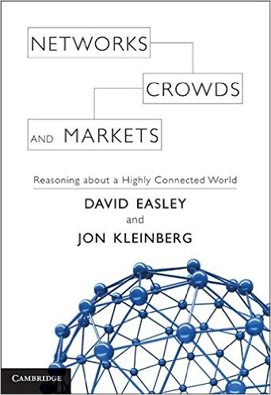
Reading
Sections 19.2-19.3

